Slide 1

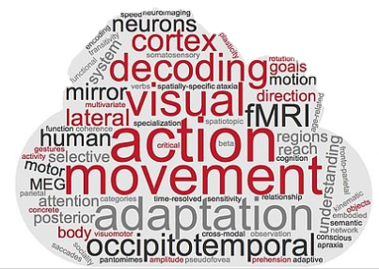
Representational similarity analysis
Day 1

Slide 2
Schedule
Day 1 (13.01.2023) | Introduction to RSA Introduction to behavioral and neuroimaging experiments Data collection – experiment in Meadows MATLAB exercises CoSMoMVPA – MATLAB-based toolbox for RSA
Day 2 (14.01.2023) | RSA - hands-on session (ROI-based RSA)
Day 3 (15.01.2023) | RSA - hands-on session (whole-brain searchlight RSA)
Day 4 (20.01.2023) | RSA - hands-on session (GLM-based RSA)
Day 5 (21.01.2023) | Neuroimgaing data preprocessing Introduction to DNNs

Slide 3
What will we need?
MATLAB
CoSMoMVPA
Meadows
Account
Stimuli (6 images)
BrainNet Viewer

Slide 4
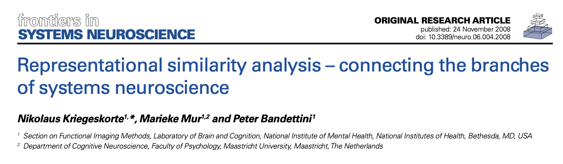
Representational Similarity Analysis (RSA)
RSA is a multivariate technique that allows one to link different types of data based on shared structure in their similarity (or distance) matrices.
Can relate brain activity patterns (neuroimaging data) to behavioral data (e.g. similarity judgements)
Stimulus description could also be the internal representation in a computational model
Nili et al., 2014
Notes:
First introduced by Kriegeskorte in 2008.

Slide 5
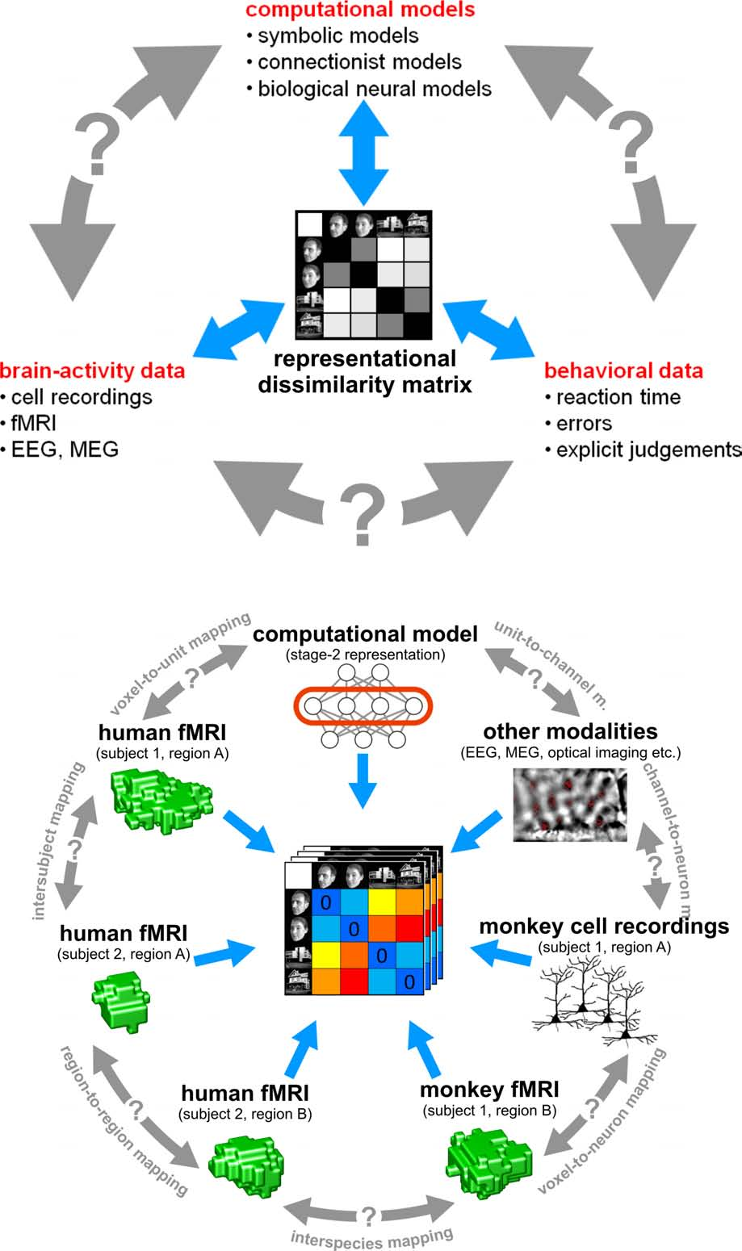
The representational dissimilarity matrix as a hub that relates different representations
Kriegeskorte et al., 2008
Notes:
A nicer visualization of what was said above.
Left panel: Three major branches of research: behavioral, brain-activity, computational modeling. Before, it’s been a struggle to relate them.
How is this possible now? By using RDMs. RDMs are created based on dissimilarities between stimuli. And information about stimuli is taken from different sources, it can be for example brain activity obtained from fMRI or ratings from behavioral experiments.
RDM can help to connect between these branches.
Panel B: Bigger details, they chose an example of fMRI to illustrate within-modality relationships.

Slide 6
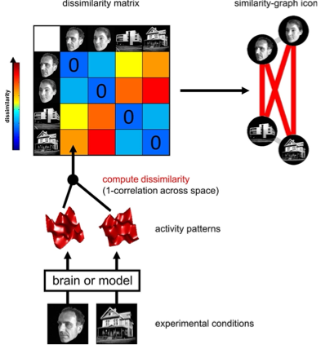
Computation of the RDM
Kriegeskorte et al., 2008
Notes:
Illustration of RDM computation, here an example on fMRI data. Stimuli elicit brain activity. We compute the dissimilarity for each pair of stimuli, for example using 1-correlation across voxels. The RDM assembles the dissimilarities for all pairs of stimuli. Here, blue color means 0 dissimilaitiy, so 100% similar. The RDM is symmetric with zeros on diagonal. They plotted the similarities on a graph to visualize the representations.

Slide 7
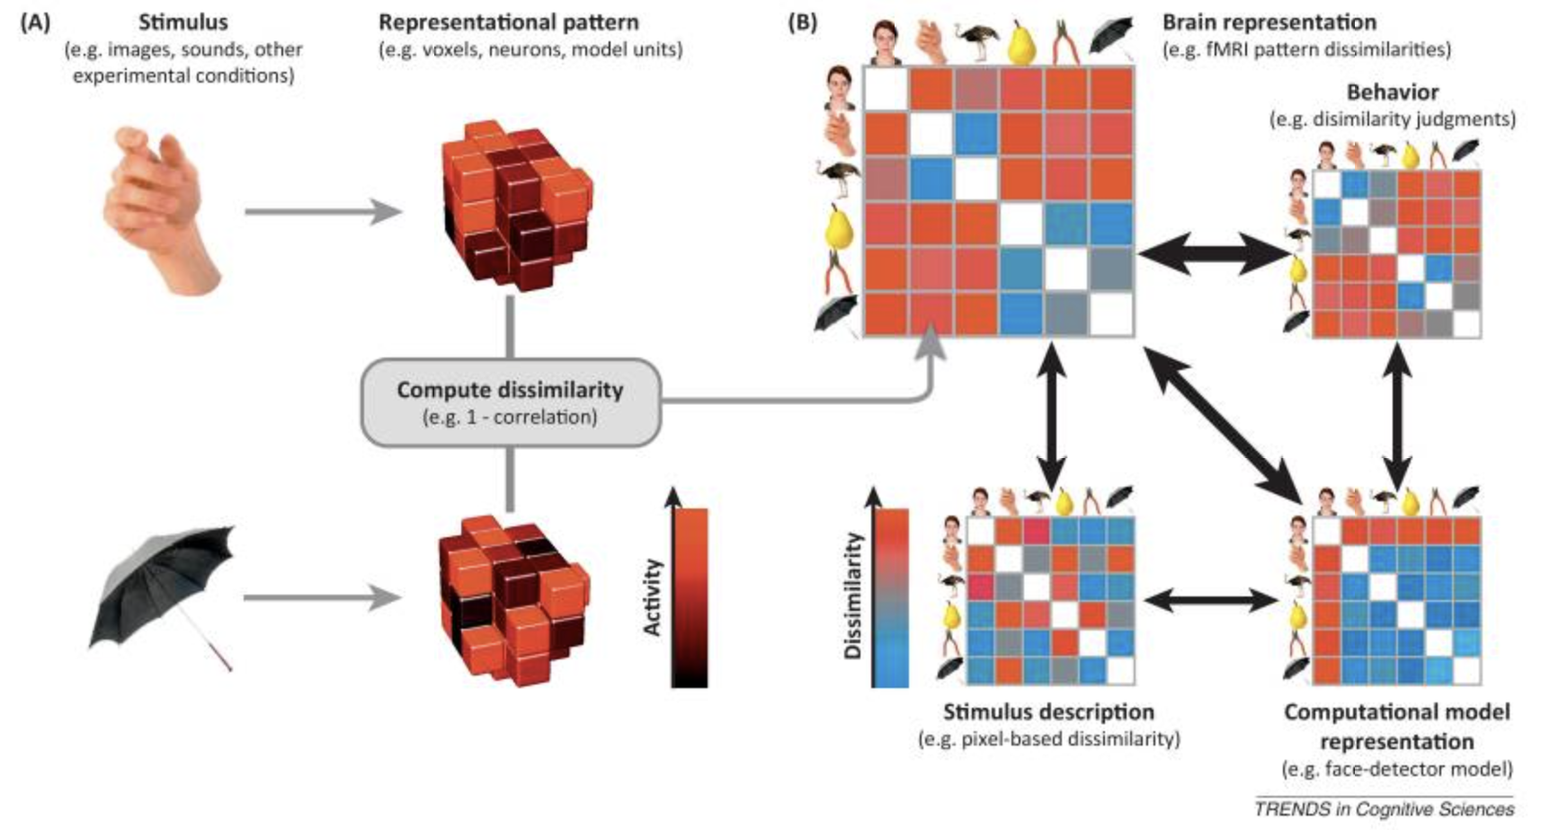
Kriegeskorte & Kievit, 2013
Notes:
Here is an illustration of the steps of RSA for a simple design with 6 visual stimuli. What I showed you on the previous slide is an RDM computed for MRI data. But RDMs can be similarly computed from behavioral experiments (top right), from internal representations in computational models (bottom right), and from stimulus descriptions (bottom left). By correlating RDMs (black double arrows), we can then assess to what extent the brain representation is reflected in behavior, can be accounted for by different computational models, and reflects stimulus properties.

Slide 8
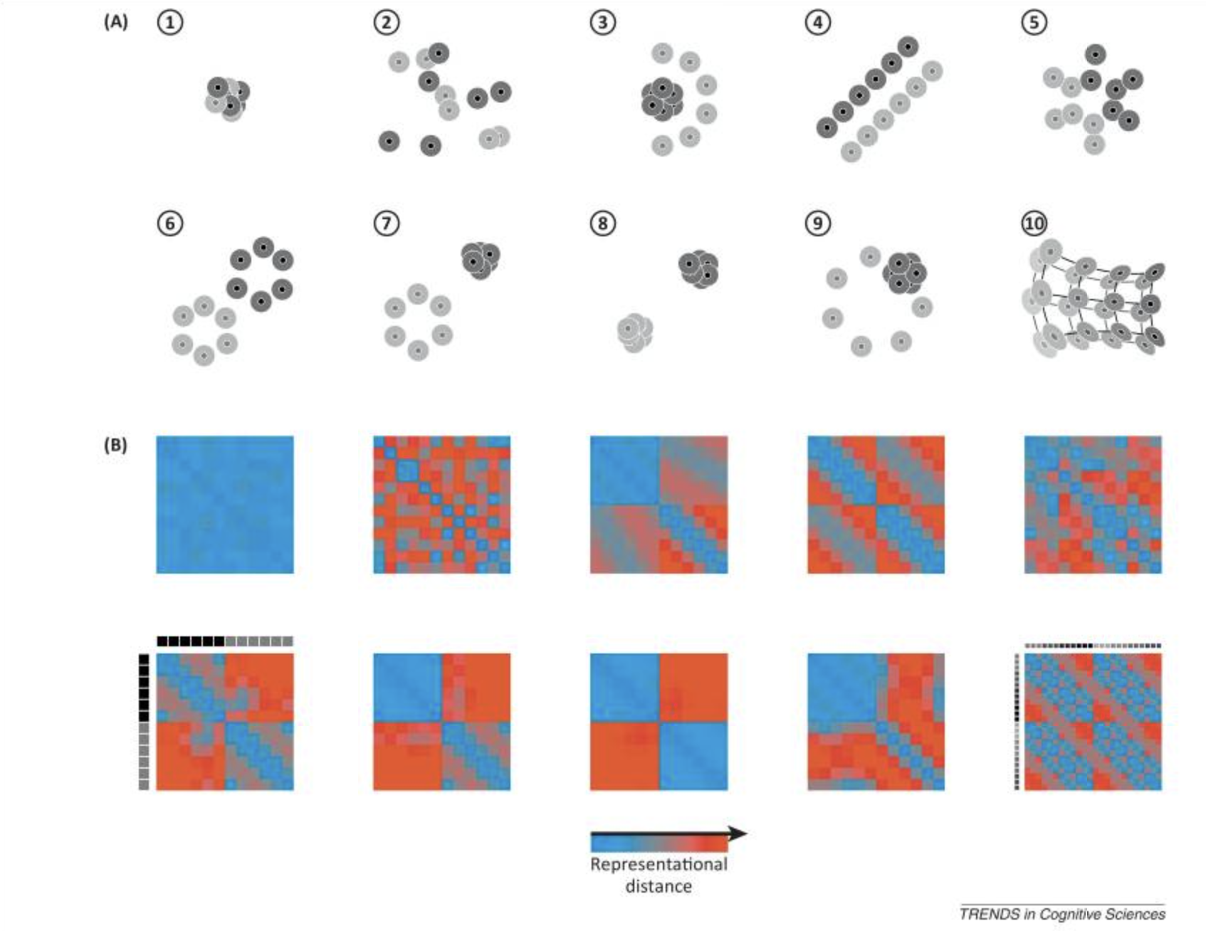
Representational geometries and their reflection in distance matrices
Kriegeskorte & Kievit, 2013
Notes:
Illustration of ten hypothetical representational geometries for brain regions (numbered 1–10). Each dot corresponds to the representation of a particular piece of content (e.g., a visual object). The space in which the dots are placed is the space of representational patterns (illustrated as two-dimensional, but high-dimensional in reality). The halo regions around the dots indicate the margin of error; dots with overlapping error halos are indistinguishable. The items fall into two categories (dark or light), or in the case of geometry 10, on a continuous manifold (shades of gray). For example: (1) No item is distinct from any other item. (2) Most items are distinctly represented but the categories cannot be separated by any simple boundary. (3) Only the light items are distinctly represented and they are separable from the dark items by a quadratic boundary. (4) Dark and light items are linearly separable and arranged along parallel lines with pairs of dark and light dots matched up across the boundary. (5) The items form a single cluster but the categories are linearly separable. (6) The items form two category clusters that are linearly separable and within which all items are distinct. (7) Like the previous case, but the items in the dark category are indistinguishable. (8) Like the previous case, but only the category distinction is represented; items within each category are indistinguishable from each other. (9) The dark items are indistinguishable and located among the distinctly represented light items on a circle. (10) Items fall on two manifolds that closely follow each other, with pairs of items matched up across them.
Below: Representational distance matrix for each of the ten geometries (in the corresponding panel location). Distances are color-coded from blue (items indistinguishable) to red (items widely separated). Each matrix is indexed vertically (from the top down) and horizontally (from left to right) by the items as illustrated in the lower left panel.

Slide 9
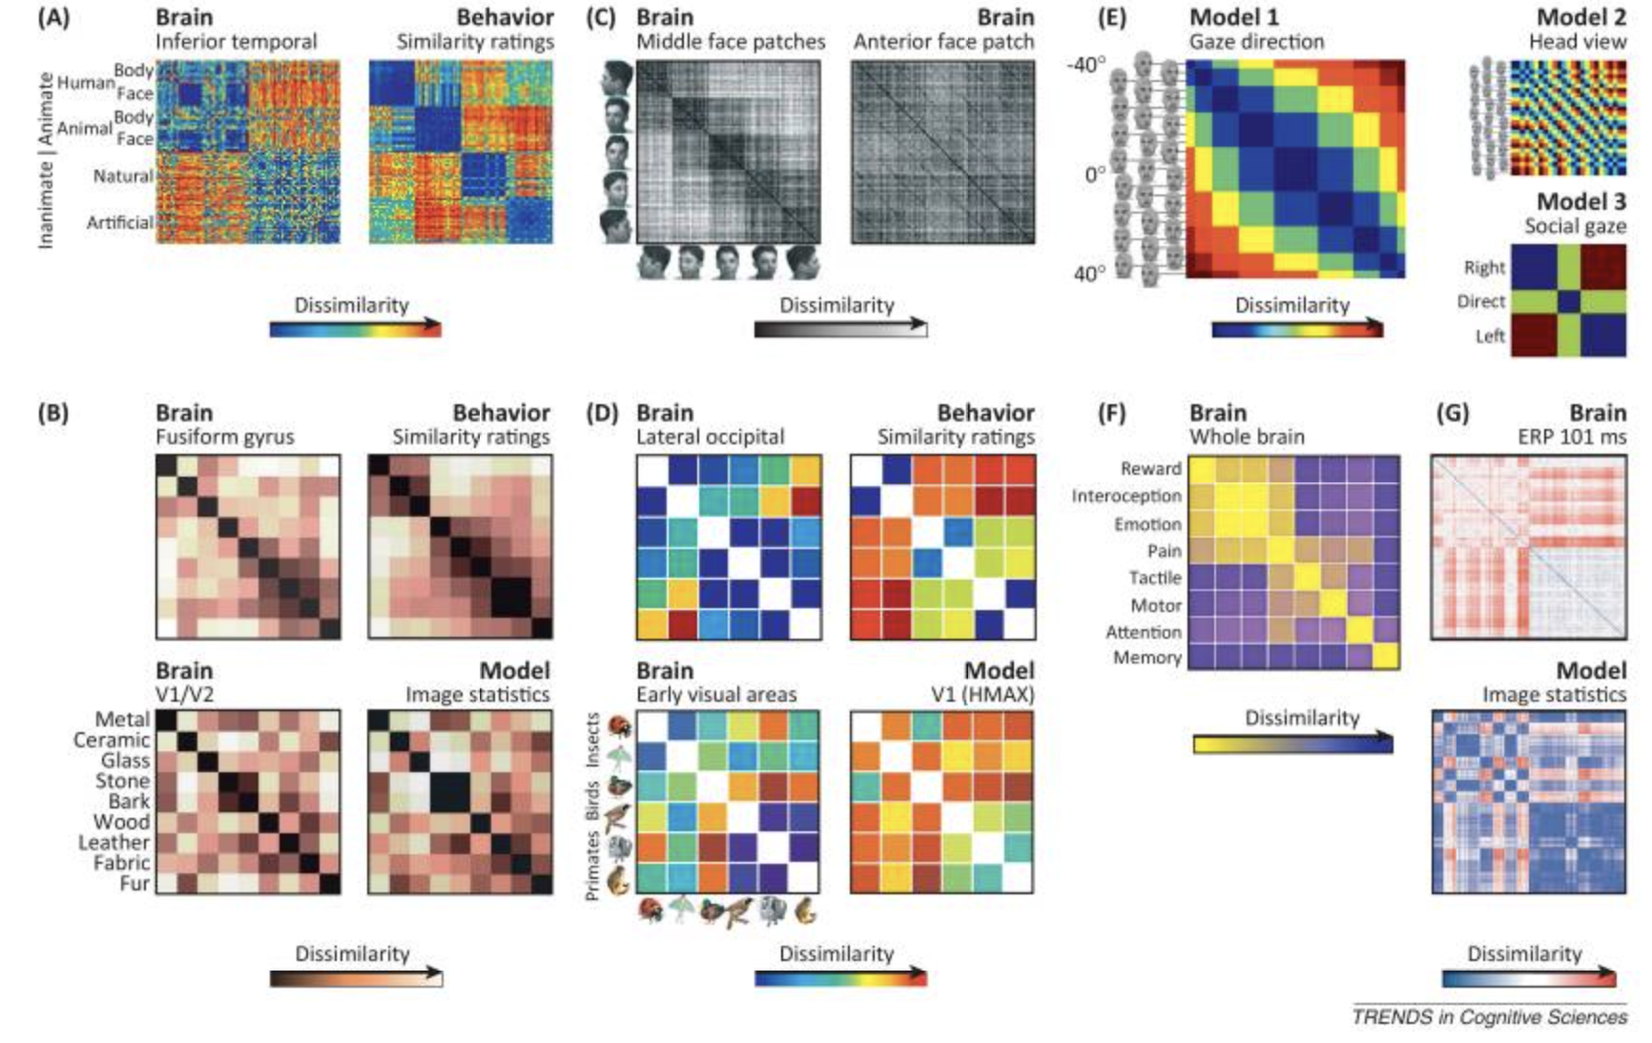
Representational dissimilarity matrices in recent studies
Kriegeskorte & Kievit, 2013
Notes:
Some examples. (A) RDM from fMRI patterns in human IT and RDM based on human dissimilarity judgments. (B) RDMs from fMRI responses to natural visual textures from a model of low-level image statistics and from human similarity ratings. (D) RDMs from fMRI responses to images of animals from six species in three biological categories and from a computational model of V1 and subject judgments of biological similarity. (E) Gaze direction. (F) Whole-brain activity pattern dissimilarities between different functional states. Etc

Slide 10
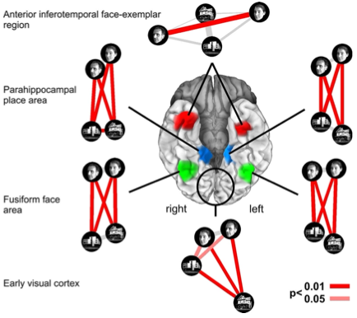
Characterizing brain regions by representational similarity structure
Kriegeskorte et al., 2008
Notes:
RSA can be done for separate brain regions. This way, we can see which regions show similarities with which model. Here, for each region, a similarity-graph icon shows the simlarities between the activity patterns elicitd by four stimulus images. Images placed close together in the icon elicited similar response patterns. Images places apart elicited dissimilar response patterns. The color of each connection line indicates whther the response-pattern difference was significant for the group

Slide 11
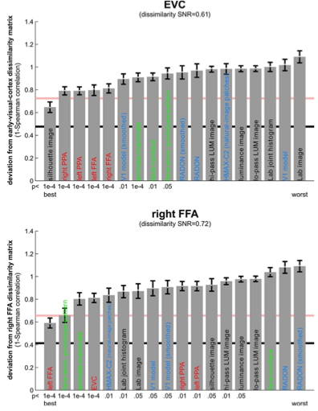
Matching models to brain regions by comparing RDMs
Kriegeskorte et al., 2008
Notes:
The dissimilarity matrices characterizing the representation in early visual cortex (top) and the right FFA (bottom) are compared to dissimilarity matrices obtained from model representations and other brain regions. Each bar indicates the deviation between the RDM of the reference region (early visual cortex or the right FFA) and that of a model or other brain region. The deviation is measured as 1 minus the Spearman correlation between dissimilarity matrices

Slide 12
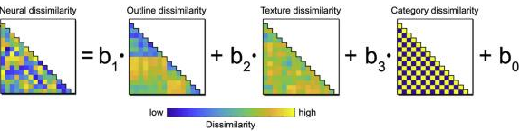
Different variants of RSA
Standard RSA (with only one model)
ROI-based
Whole-brain searchlight
Multiple regression based RSA (with more than one model. Additional models are regressed out)
ROI-based
Whole-brain searchlight
Proklova, Kaiser, & Peelen, 2019, Neuroimage

Slide 13
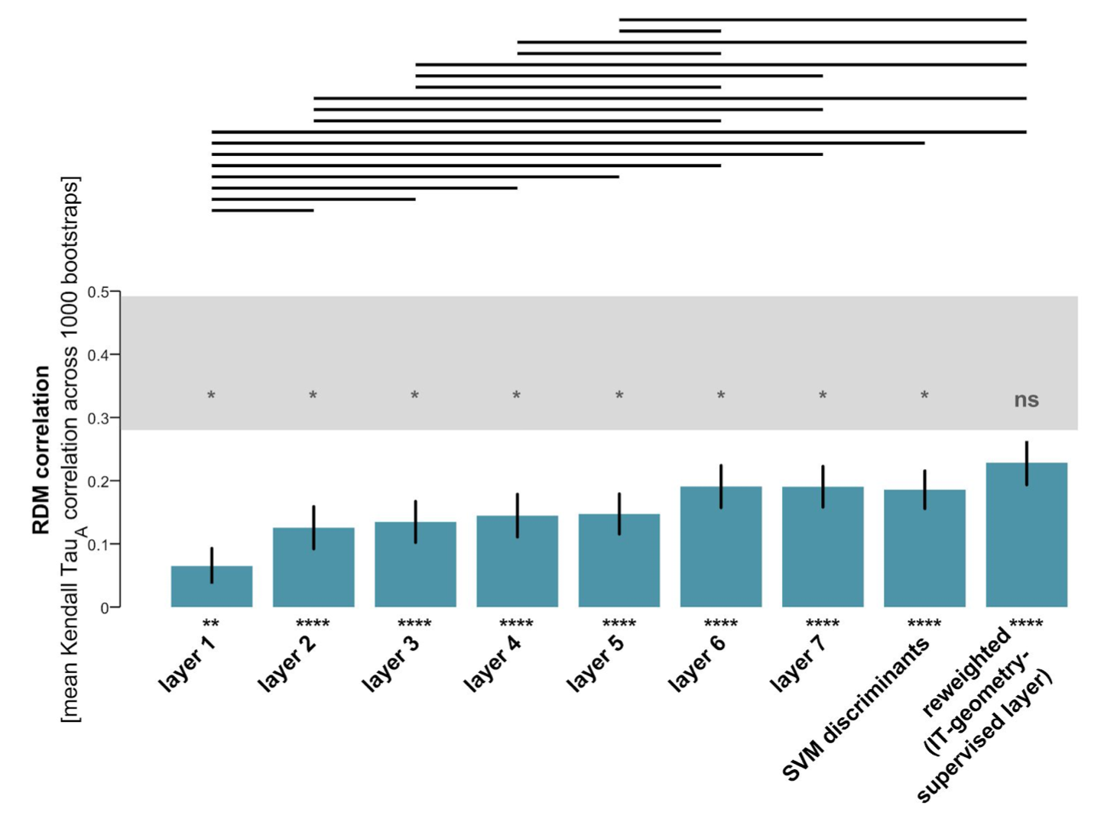
The noise ceiling
The expected RDM correlation achieved by the (unknown) true model, given the noise in the data
Important for accessing to what extent the failure of a model to reach an RDM correlation close to 1 is caused by a deficiency of the model or by the limitations of the experiments (e.g. high measurement noise and/ or limited amount of data)
If best model does not reach the noise ceiling: seek a better model
If best model reaches the noise ceiling, but ceiling is far below 1, improve your experimental technique to gain sensitivity
Storrs et al., 2020

Slide 14
The noise ceiling
Upper bound: estimated by computing the correlation between each subject’s RDM and the group-average RDM
Lower bound: estimated by computing the correlation between each subject’s RDM and the average RDM of the other subject’s RDMs (leave-one-out approach)

Slide 15
Distance measure
Correlation distance (1 minus the Pearson correlation, computed across voxels or sites of the two activity patterns)
Euclidean distance (square root of the sum of squared differences between the two patterns)
Mahalanobis distance (Euclidean distance after linearly recoding the space as to whiten the noise)
Nili et al., 2014
Notes:
First introduced by Kriegeskorte in 2008 (?)

Slide 16
Which correlation coefficient to use when comparing RDMs
‘Spearman’ – default (Cambridge RSA Toolbox), because they prefer not to assume a linear relationship between the distances
‘Kendall’s tau’ – appropriate whenever categorical models are tested
‘Pearson’ – may be justified when RDMs from the same origin (e.g. multiple computational models or multiple brain regions measures with the same methods) are compared
Notes:
In the Cambridge RSA Toolbox

Slide 17
How to transform single-subject RDMs to determine ‘central’ RDM (to determine upper and lower bound of noise ceiling)
For Spearman: rank-transformation
For Kendall’s tau: average ran-ttansformed single-subject RDMs and use iterative procedure to find the RDM that has the maximum average correlation to the single-subject RDMs
For Pearson: z-transformation

Slide 18
How to best measure the dissimilarityy between two patterns?
[Classification accuracy]
Euclidean/ Mahalanonis distance
Squared euclidean distance
Pearson correlation distance
Crossvalidated estimaes of the distance
Continuous distance measuress
Walther et al., 2015

Slide 19
Basics of RSA
Present participants with a range of different experimental conditions (e.g. distinct stimuli)
Measure correlate of neuronal activity at multiple brain locations
Activity pattern: vector of activity amplitudes across reponse channels (e.g. voxels) within a region of interest
Each stimulus is associated with an activity pattern -> interpreted as the representation of the stimulus
Nili et al., 2014

Slide 20
Running RSA on your own data

Slide 21
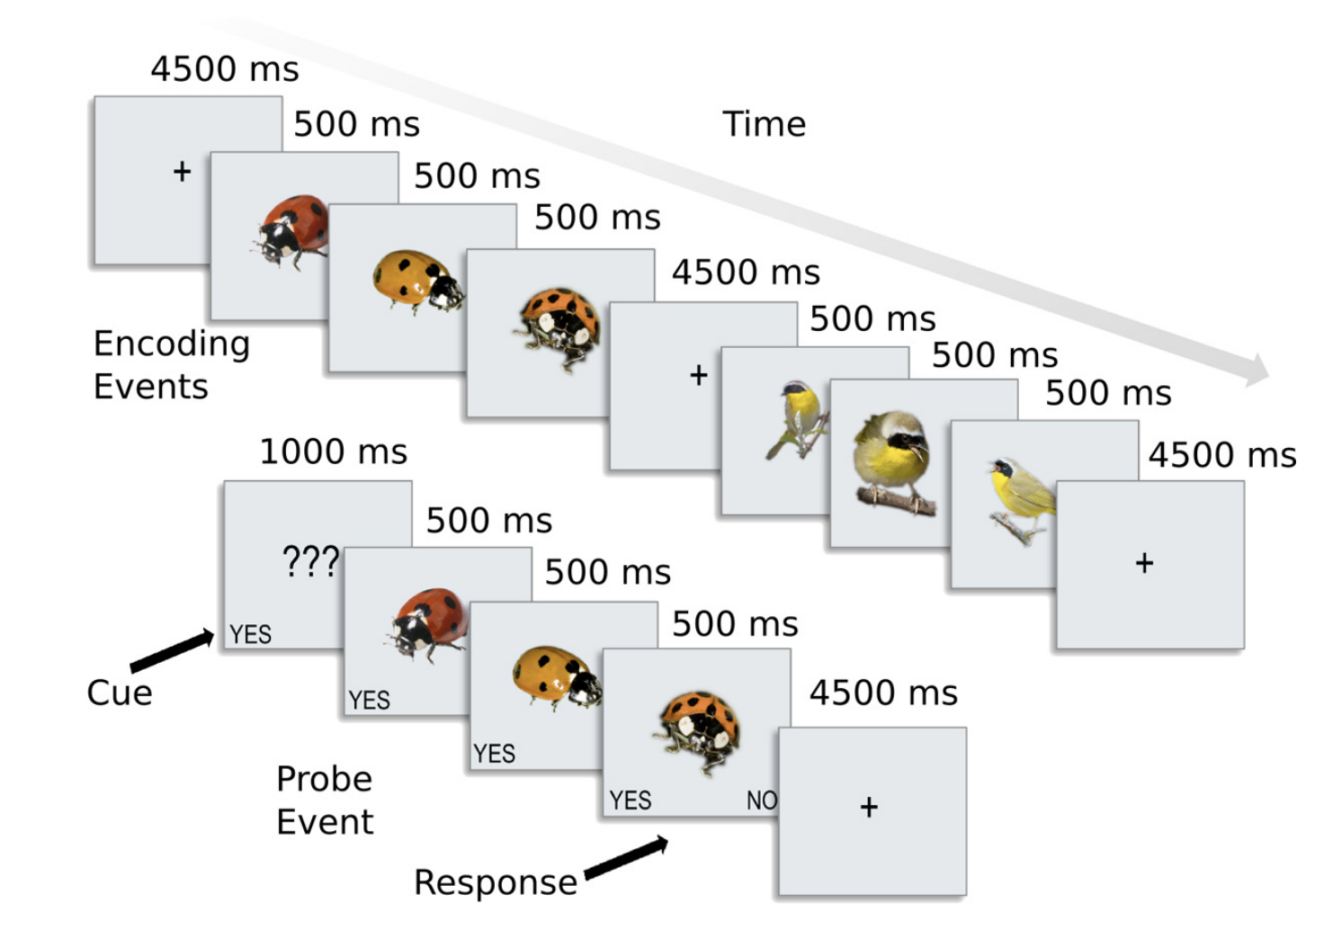
Dataset
Conolly et al., 2012
fMRI study (event-related design)
8 participants
Stimuli:
Six species: ladybird, luna moths, yellowthroat warblers, mallard ducks, lemurs, and monkeys
64 unique images for each species (384 images in total)
Figure 1
Conolly et al., 2012
Notes:
We’ll take data from the paper of Conolly et al, 2012. They did XXX. We’ll use data that they obtained in MRI so we’ll get activity patterns for each presented animal. This, we’ll correlate with behaviorl ratings. They actually already did this (Figure 2) but we’ll get our own behavioral ratings.

Slide 22
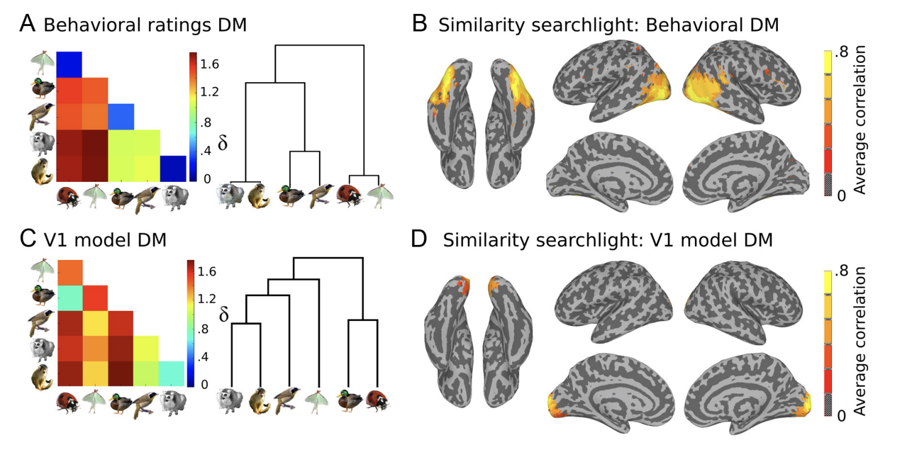
Dataset
Behavioral similarity judgments: to “choose the odd-one-out” given a set of three animals.
V1 model similarity structure: low-level visual properties such as retinotopic shape biases and spatial frequency information based on a model of V1 cortical neurons (Serre et al., 2007).
Figure 2
Conolly et al., 2012
Notes:
We’ll take data from the paper of Conolly et al, 2012. They did XXX. We’ll use data that they obtained in MRI so we’ll get activity patterns for each presented animal. This, we’ll correlate with behaviorl ratings. They actually already did this (Figure 2) but we’ll get our own behavioral ratings.

Slide 23
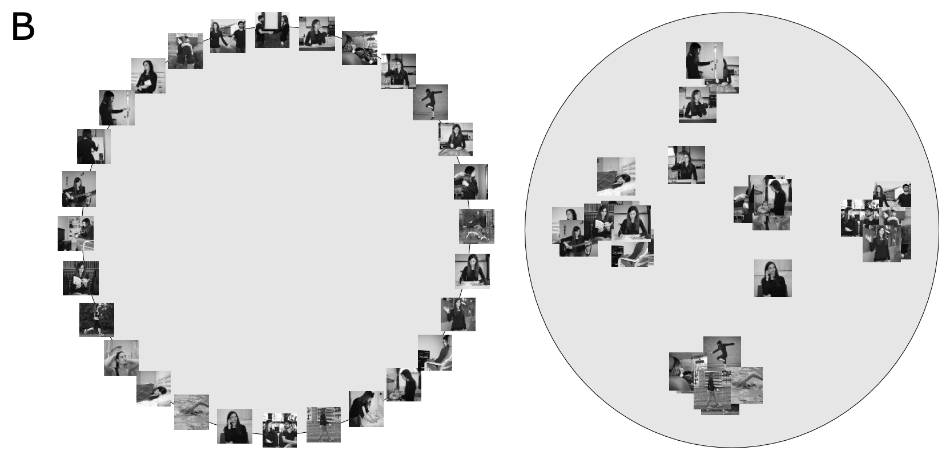
Inverse multidimensional scaling
“Inferring dissimilarity structure from multiple item arrangements”
the dissimilarity matrix is estimated by “inverse MDS” based on multiple arrangements of item subsets
the subsets are designed by an adaptive algorithm that aims to provide optimal evidence for the dissimilarity estimates
Tucciarelli et al., 2019
Notes:
Introduced by Kriegeskorte and Mur (2012).
Previous methods were e.g. pairwise similarity judgements, free sorting etc.
The multi-arrangement method uses a circular arena. The subject arranges the items (represented as icons on a computer screen) by means of mouse drag-and-drop operations.
It is faster, the similarities are judged in a context and also this method allows characterizing continuous high-dimensional dissimilarity structures.

Slide 24
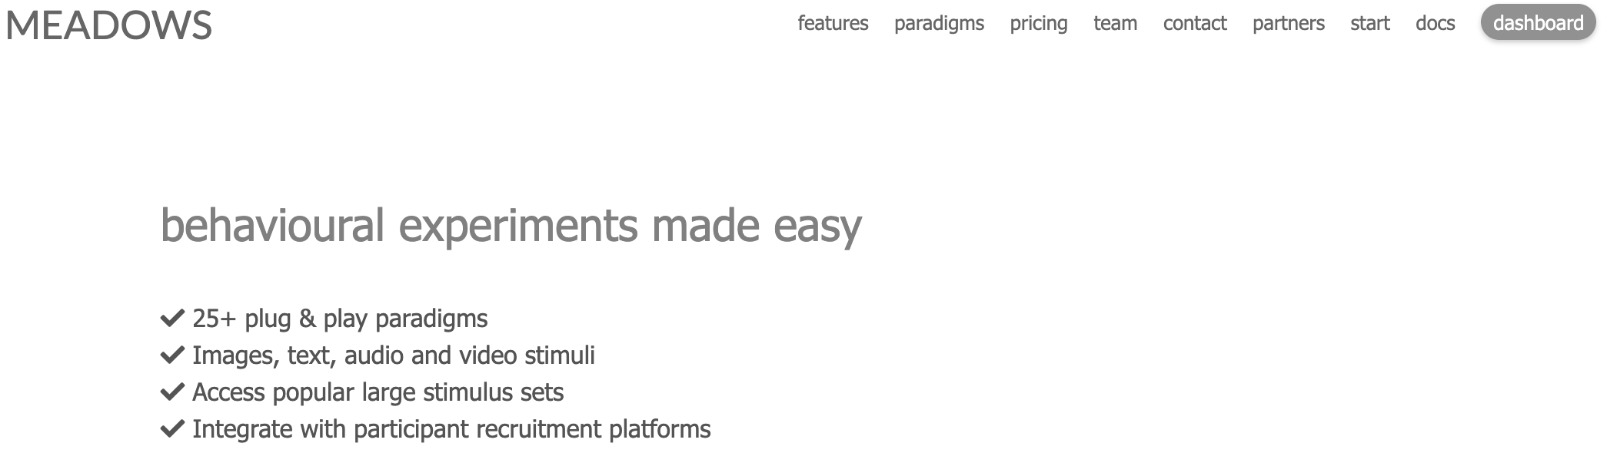
Meadows
Notes:
Meadows – many behavioral experiments, like visual search, timed keyboard response, triplet choice, etc.
But today we’ll do so-called inverse MDS

Slide 25
Meadows
Where to start?
Create an account (https://meadows-research.com/ )
Get the stimuli
Done! What next?
Prepare an inverse MDS experiment
Add demographic information and description of the study
Run the experiment by yourself (remember: set the time limit to 5 min)
Download the results (.mat file)

Slide 26
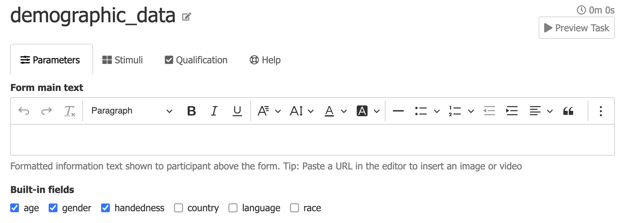
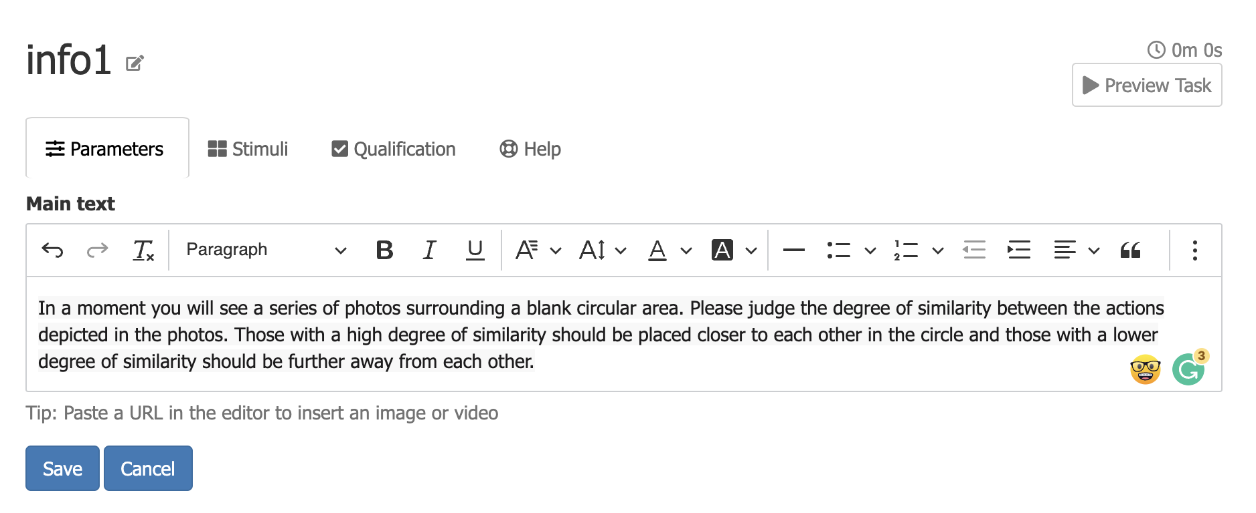
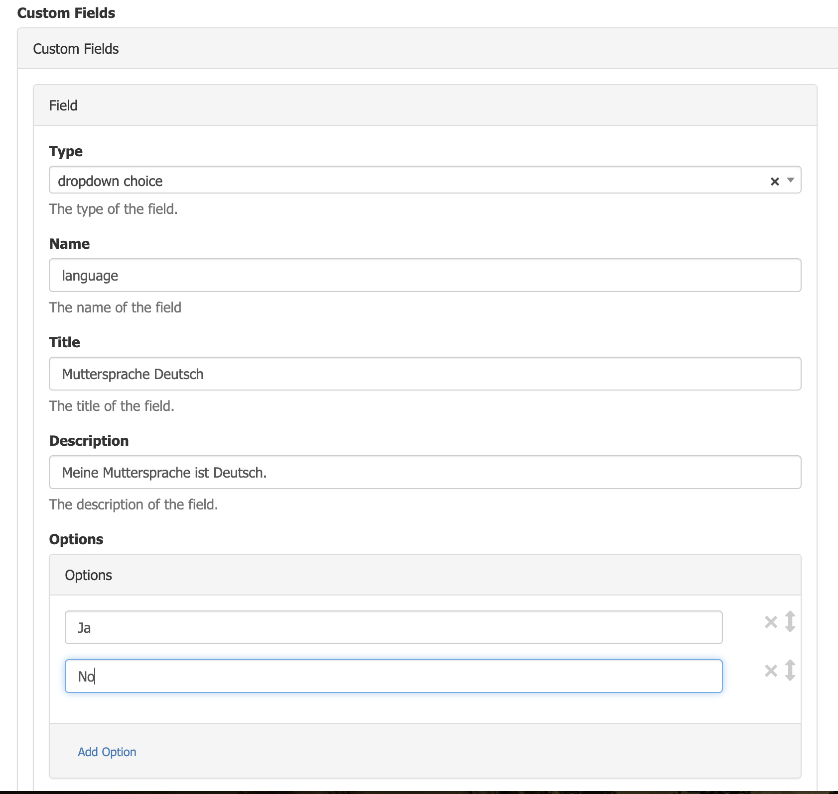
1. Demographic data (Dynamic form)
2. Info (General Information)

Slide 27
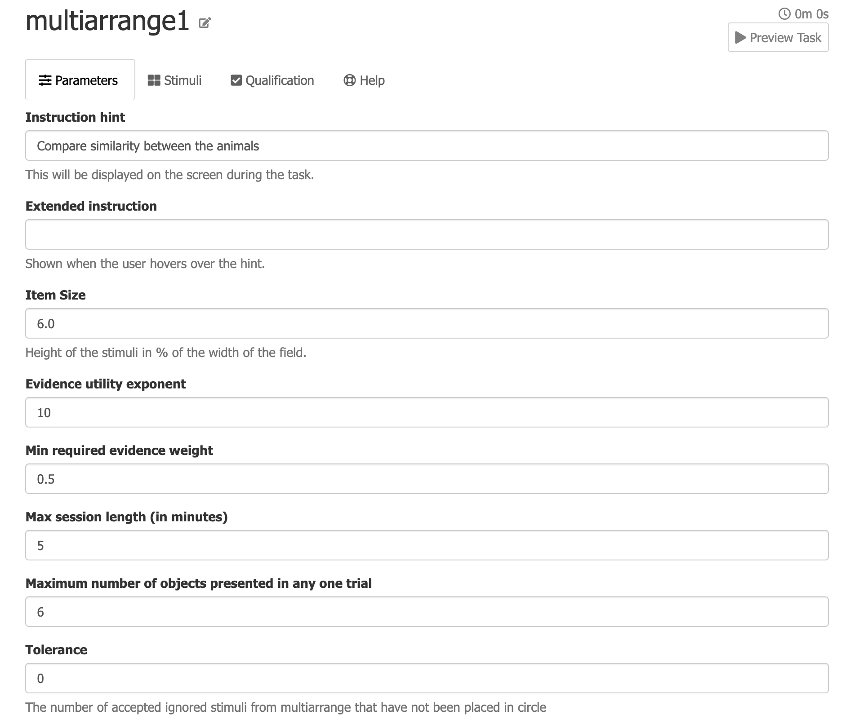
3. Multi-arrangement experiment (Multi Arrangement)

Slide 28
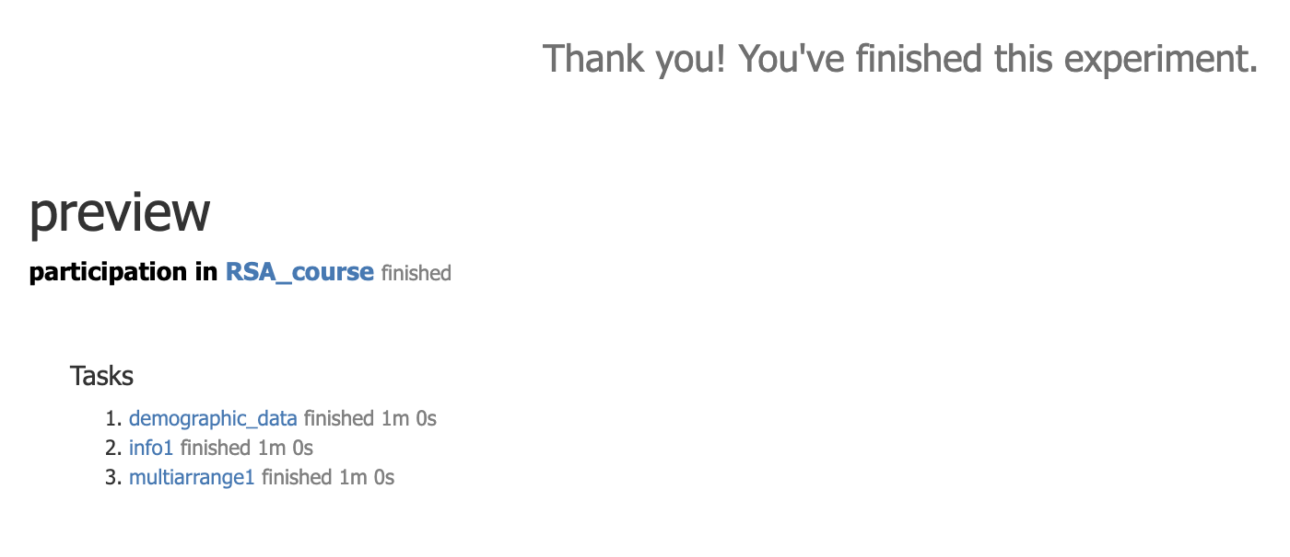
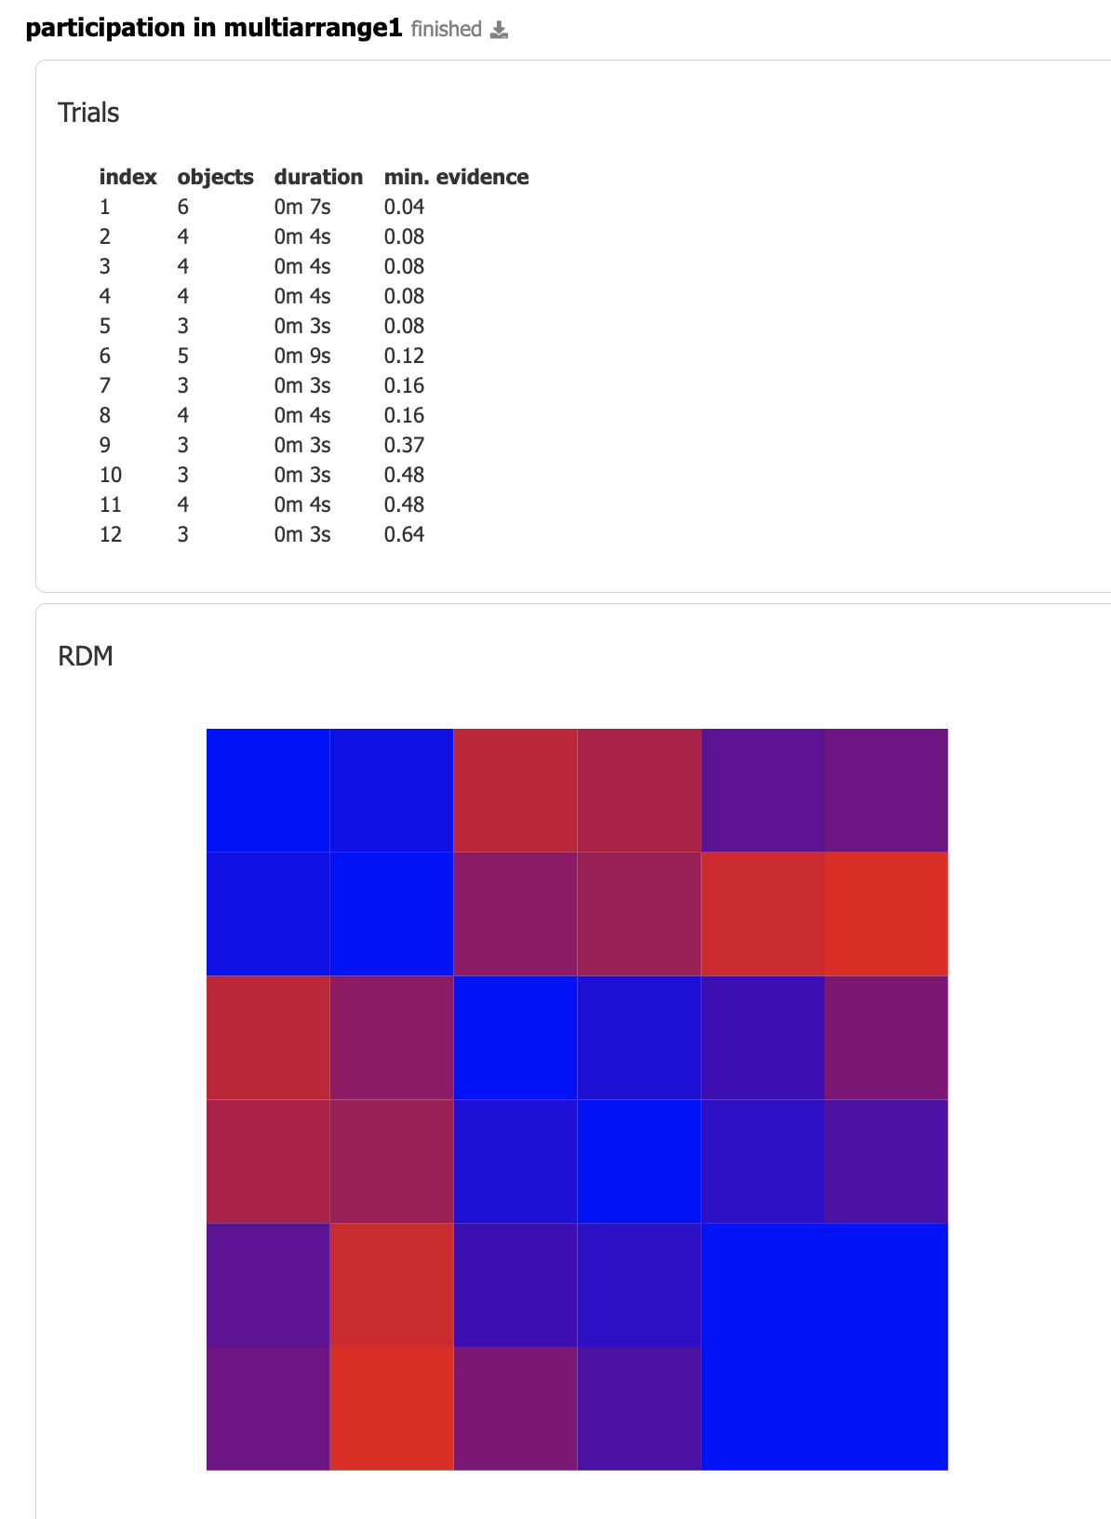
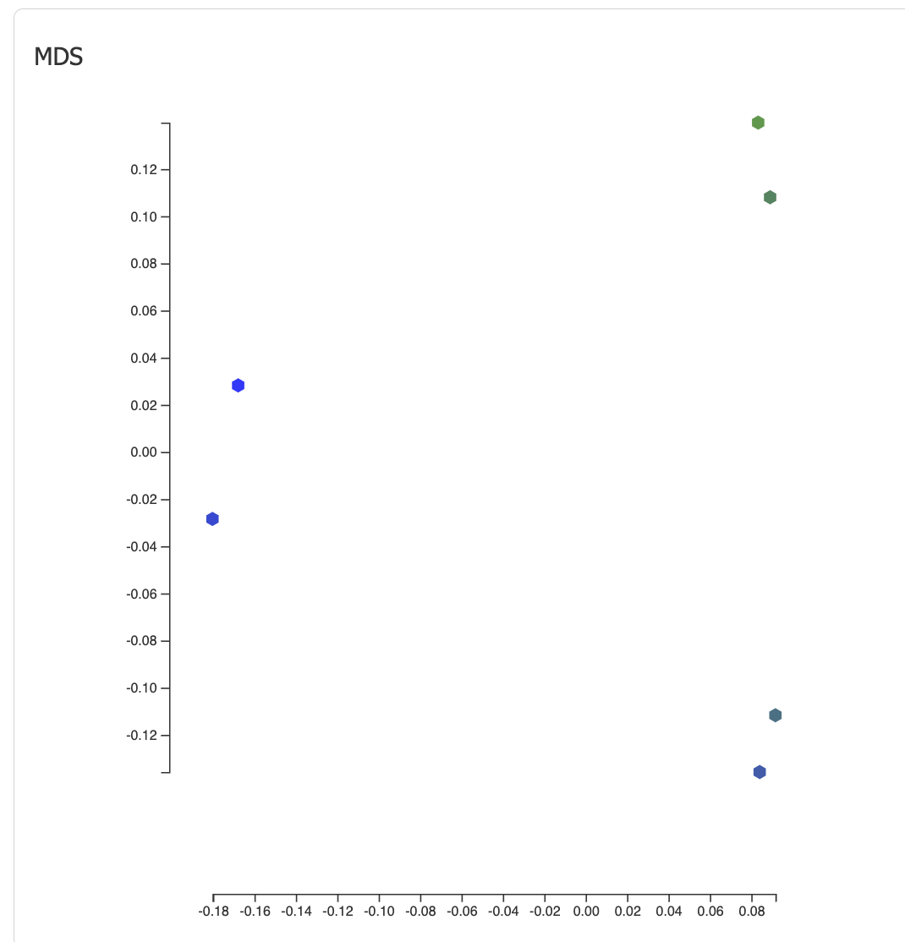

Slide 29
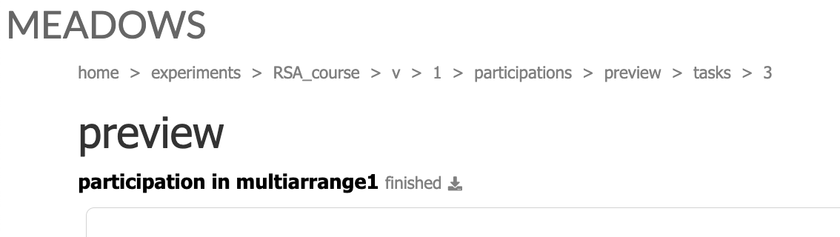
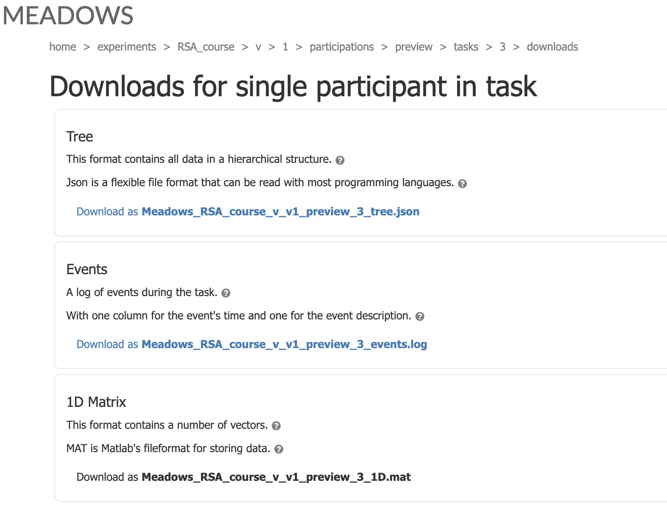

Slide 30
Matlab: from beginner to expert Day 1st

Slide 31

For beginner:
Register matlab with UR email: https://ww2.mathworks.cn/support/learn-with-matlab-tutorials.html
Explore: MATLAB Onramp

Slide 32
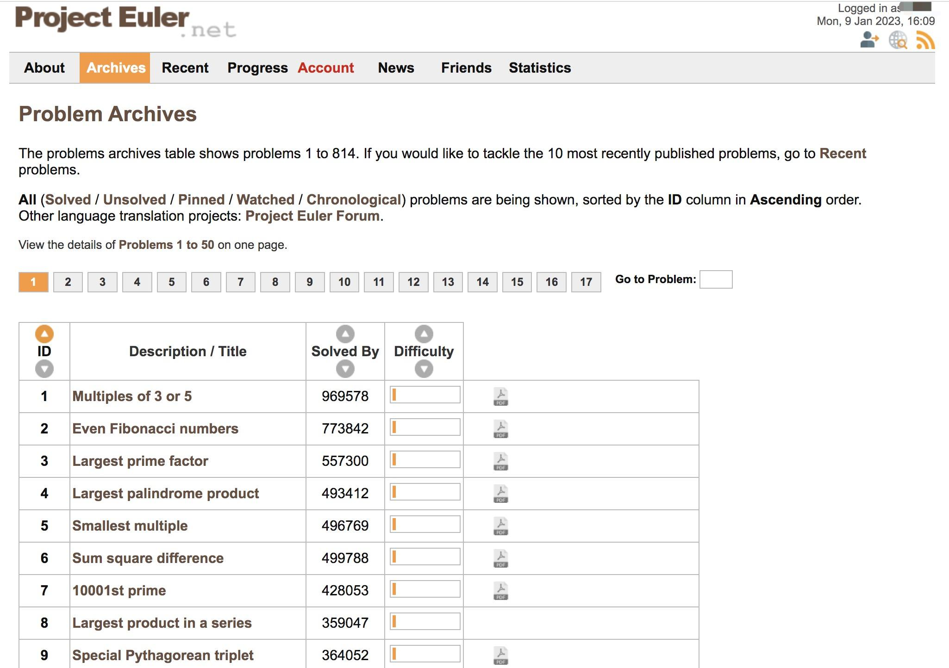
For expert:
Explore: Deep Learning Onramp in matlab tutorials
Have fun with Problem Archives (https://projecteuler.net/archives)
Register
Play

Slide 33
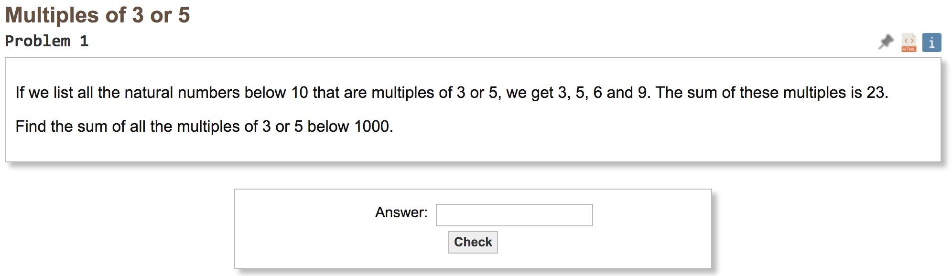
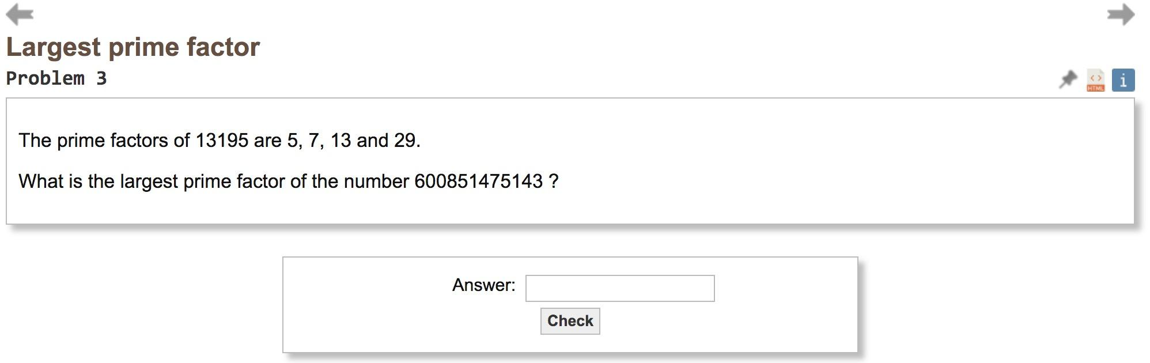

Slide 34
Exercise 1. Getting familiar with CoSMoMVPA.
Dowload data: https://cosmomvpa.org/download.html
description of dataset
Six categories (monkey, lemur, mallard, warbler, ladybug, lunamoth) during ten runs in an fMRI study. Using the General Linear Model response were estimated for each category in each run, resulting in 6*10=60 t-values.
6 categories x 10 runs

Slide 35
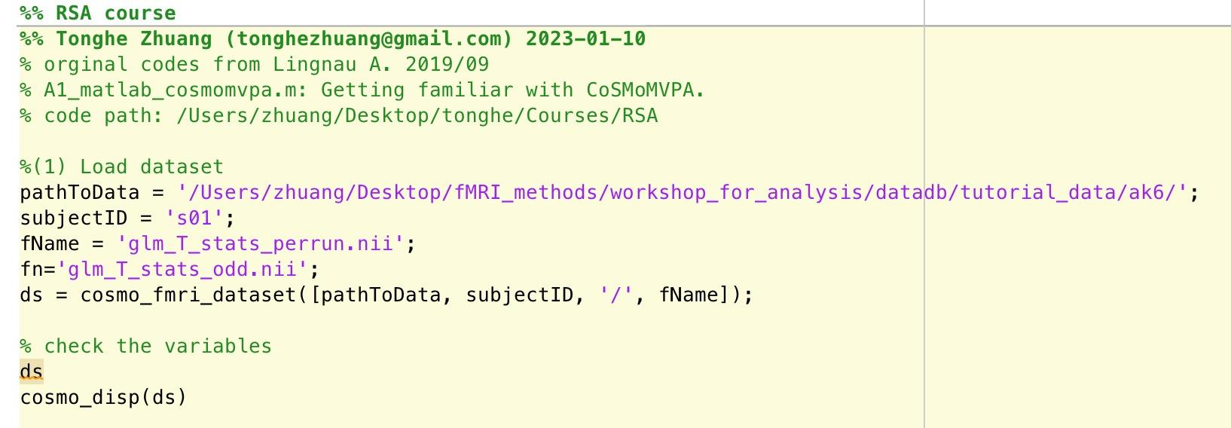
Exercise 1. Getting familiar with CoSMoMVPA.
Dowload data: https://cosmomvpa.org/download.html description of dataset
Six categories (monkey, lemur, mallard, warbler, ladybug, lunamoth) during ten runs in an fMRI study. Using the General Linear Model response were estimated for each category in each run, resulting in 6*10=60 t-values.
In Matlab, open the first exercise (RSA_matlab_cosmomvpa_01.m):

Slide 36
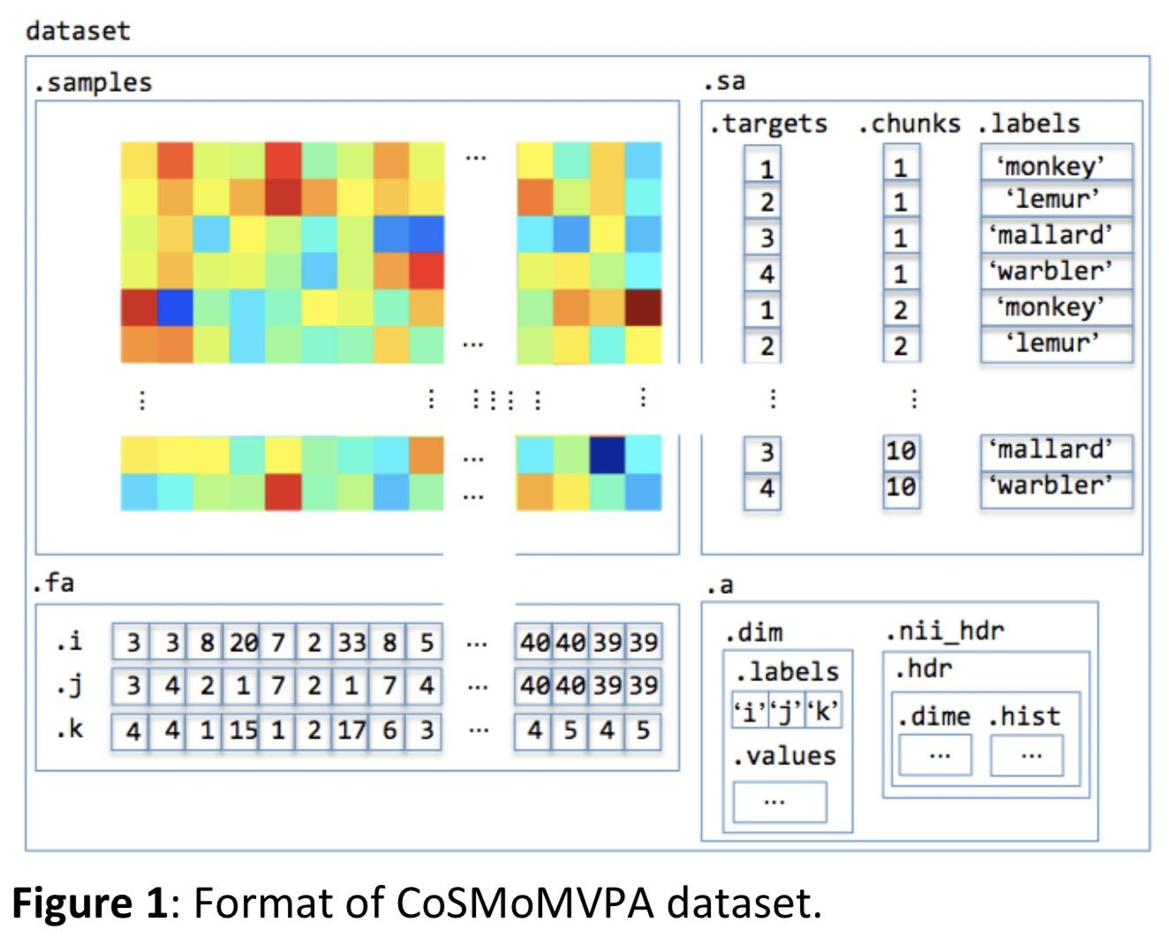
the format of the CoSMoMVPA dataset:

Slide 37
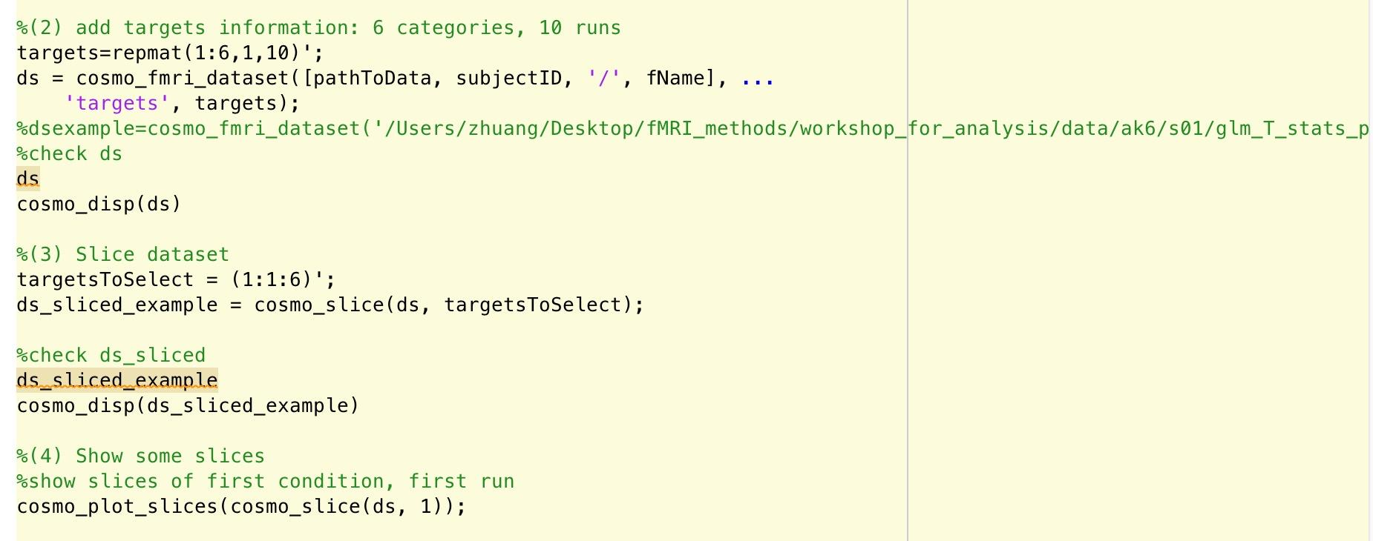

Slide 38
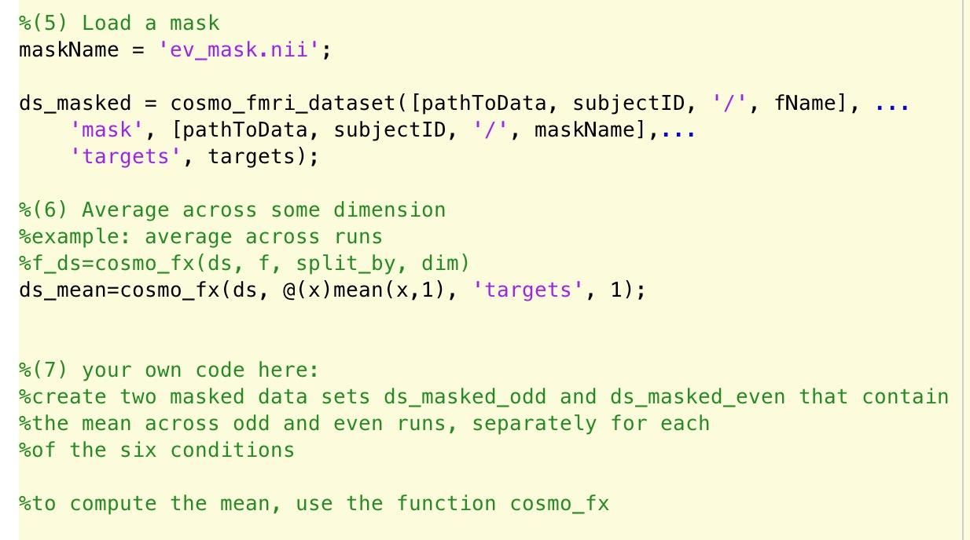

Slide 39
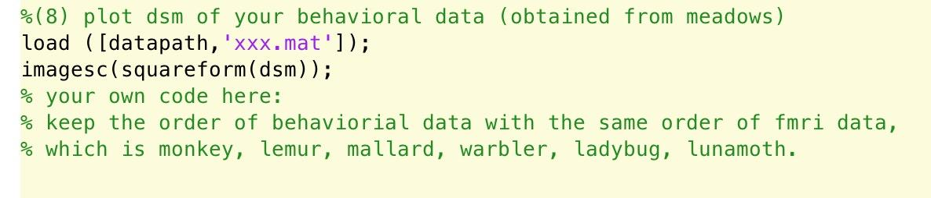

Slide 40
Q & A
Tonghe & Zuza

